Slide 1
Cab Company Comparison
by Jithin James

Slide 2
Metrics for Comparison
We use the Following metrics to identify which company to invest
Market Share
Profit Per Trip
Trend of Cost per Trip
Trend of Profit per Trip
Trend of Number of Trips
Earnings Trend
Per Kilometre fare trend
Cities with High Profits
Average Profit vs Income Group

Slide 3
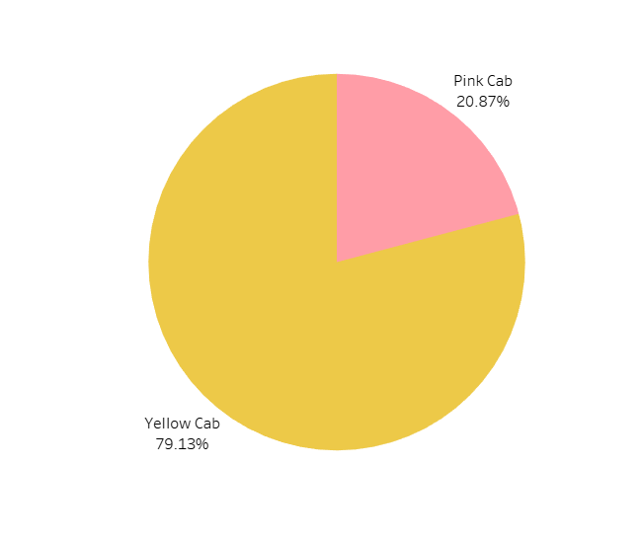

Market Share
Yellow Cab is having a Very high Market Share (79%) Compared with Pink Cab (21%)

Slide 4
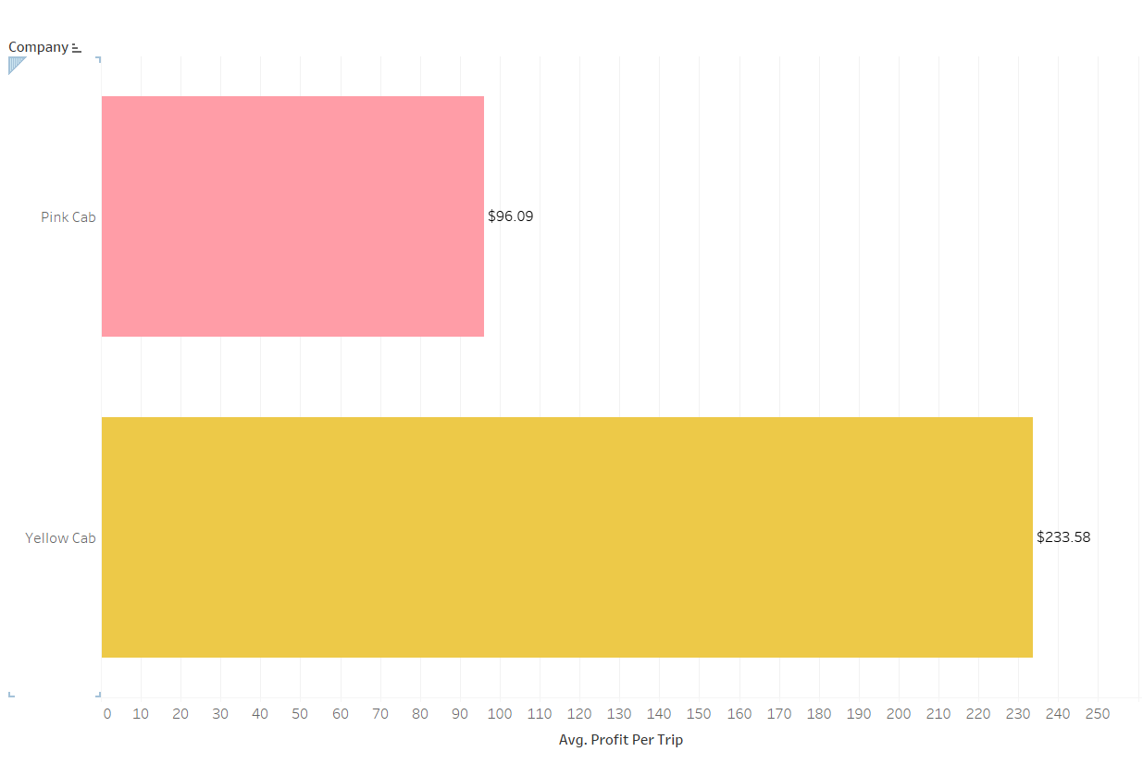
Average Profit Per Trip
Average Profit Per Trip is greater for Yellow Cab

Slide 5
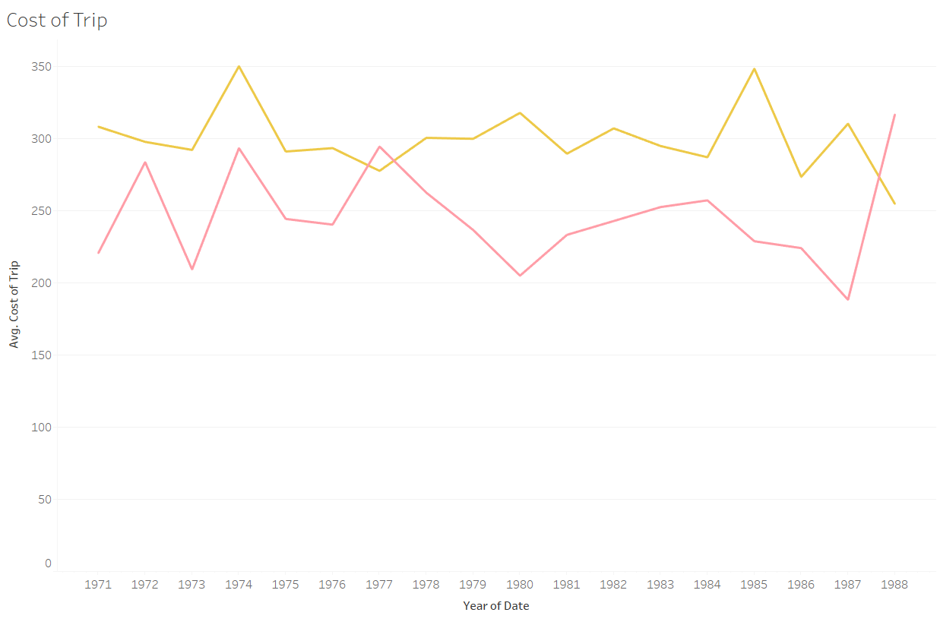
Trend of Cost per Trip
Cost per Trip is generally higher for Yellow Cab from 1971 to 1987 but there is a sudden increase in cost of trip for Pink cab from 1987

Slide 6
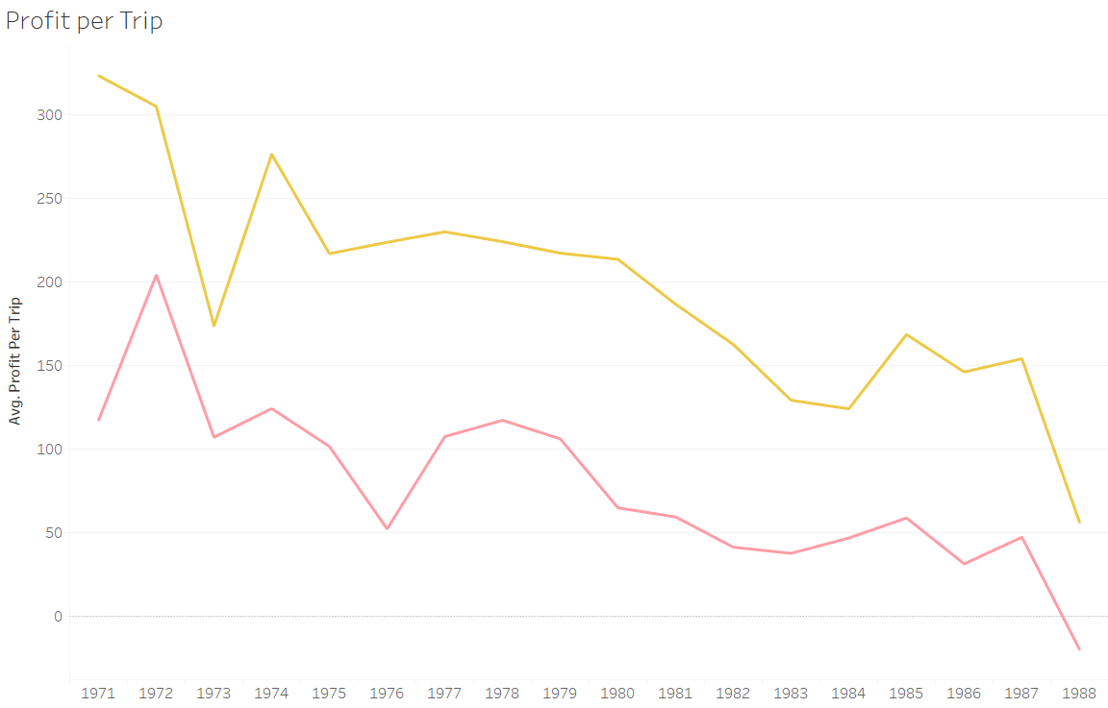
Trend of Profit per Trip
Profit per Trip is in the decline for both the Companies, but Yellow Cab in having much better profit margin

Slide 7
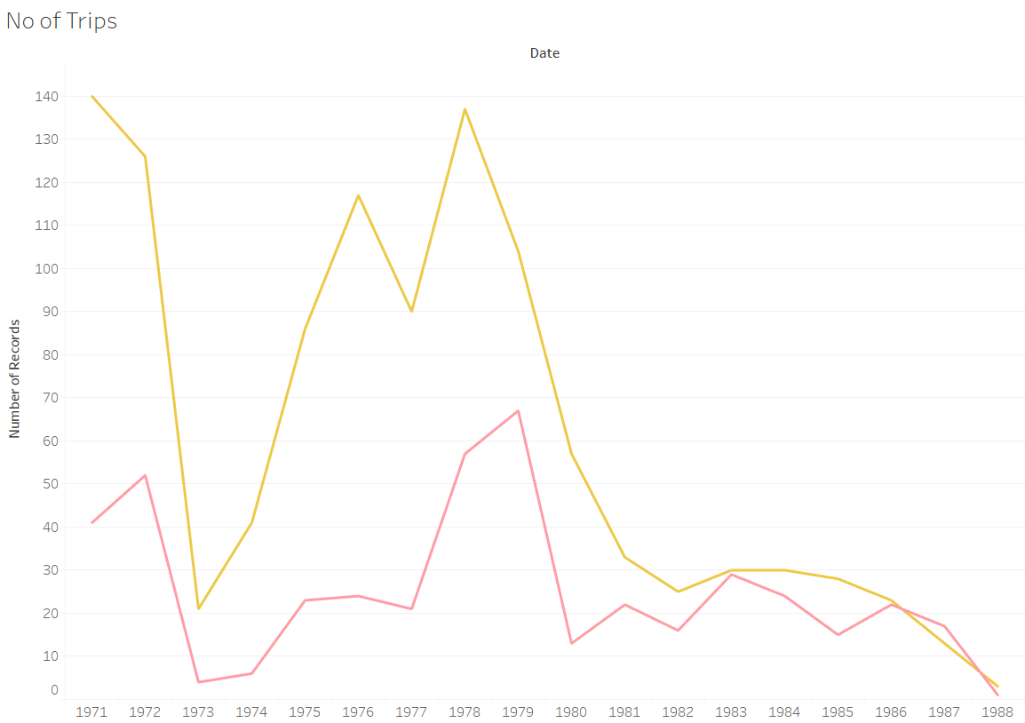
Trend of Number of Trips Taken
Number of trips taken is in decline for the companies with Pink cab Performing the worst

Slide 8
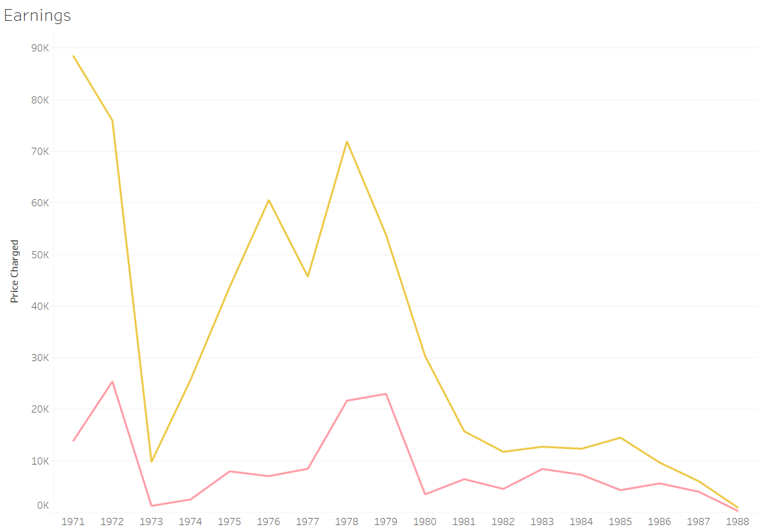
Earnings
Earnings of Yellow cab is having a step decline, while pink cab is has a slow decline. Yellow Cab has much better earnings than Pink Cab

Slide 9
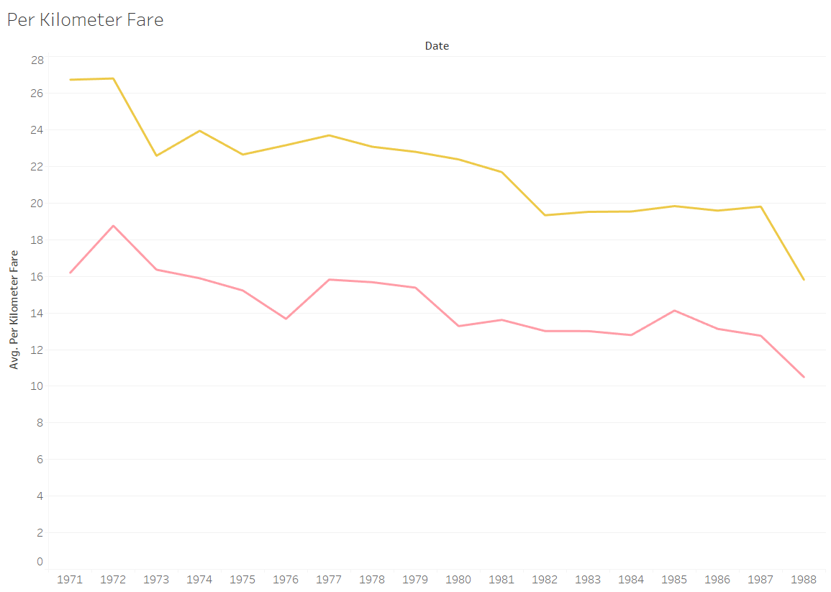
Per Kilometre Fare Trend
Per kilometre fare charged for both the companies are in the decline

Slide 10
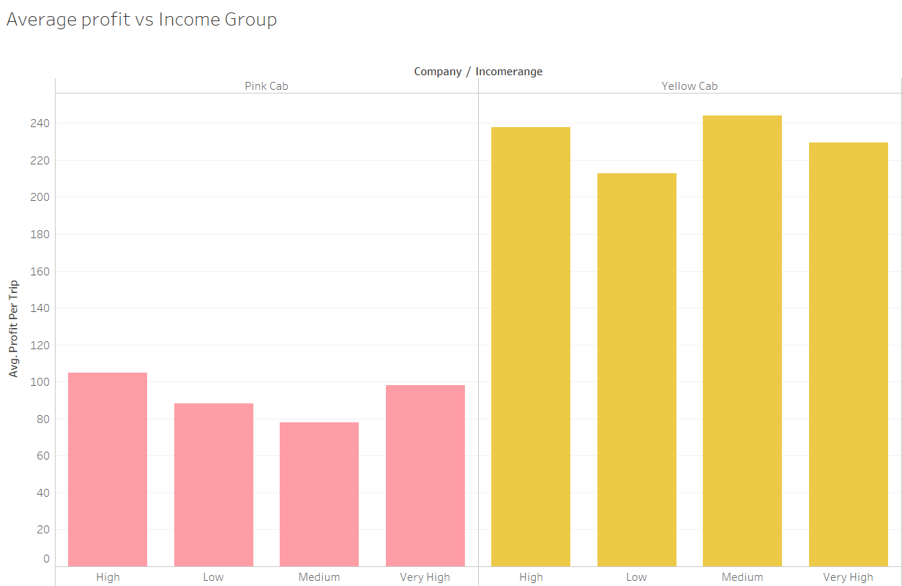
Average Profit vs Income Group

Slide 11
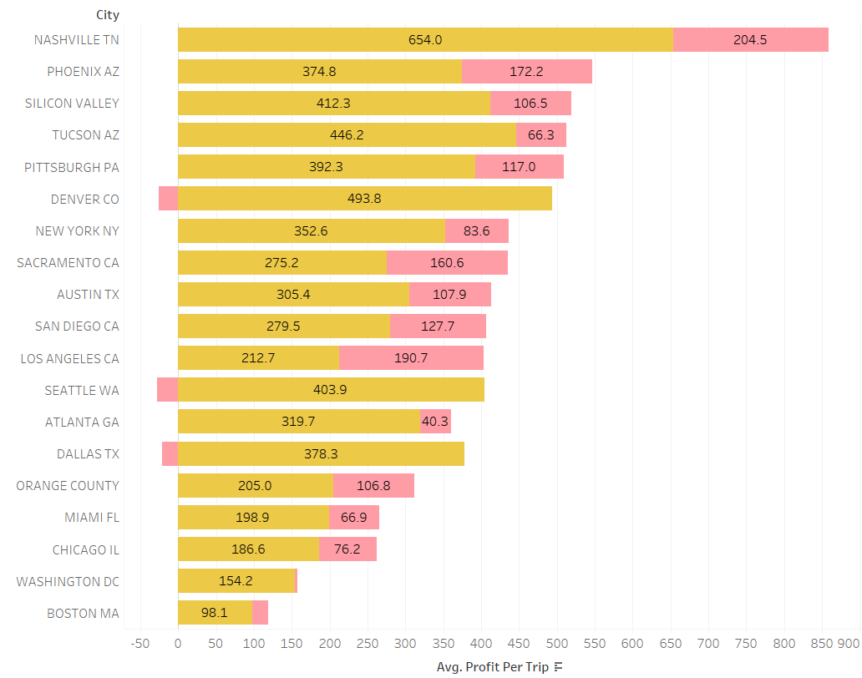
Cities with High Profits
Among the most profit making cities, the Yellow Cab is having High Profits

Slide 12
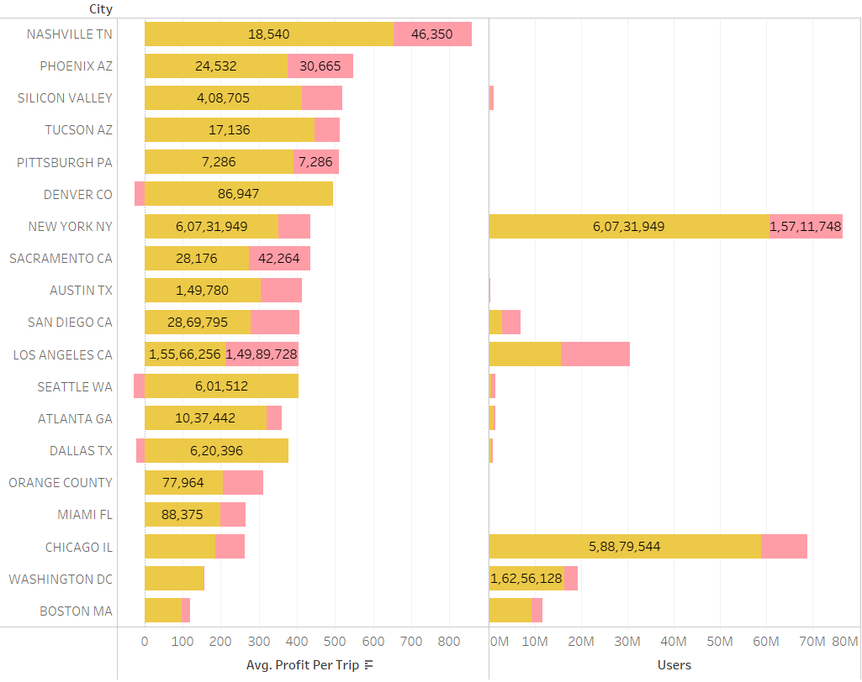
Among the Top profit making cities the user base is very low, increasing their userbase in these cities would increase the profits

Slide 13
Conclusion
From the above metrics used we can conclude the following
Yellow Cab performing much better than Pink cab in most of the comparisons, so for investment Yellow cab in the best choice among the two
But the decrease in earnings, number of rides, profits are a big concern, therefore the ideal decision would be to not invest in either of the companies

